Slide 1



15.1 Double and Iterated Integrals over
Rectangles
Review of the Definite Integral

Slide 2

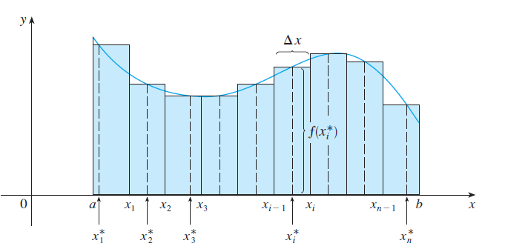

Slide 3
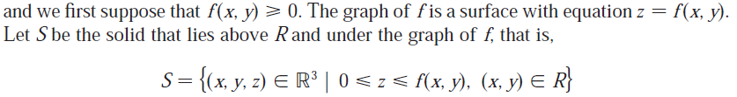
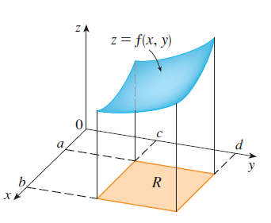
Volumes and Double Integrals
Consider a function of two variables defined on a closed rectangle
Our goal is to find the volume of S.

Slide 4
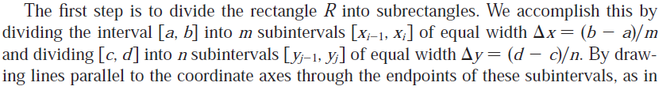

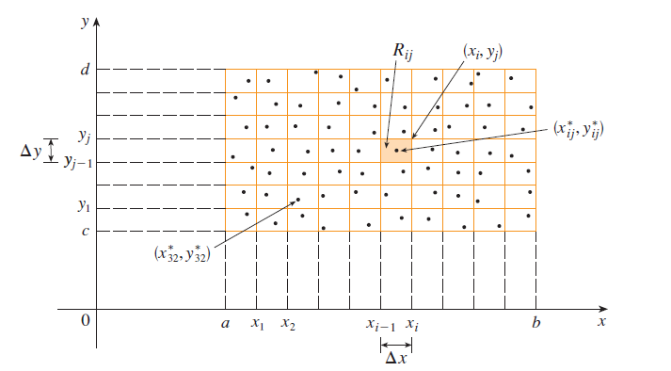
the following figure, we form the subrectangles

Slide 5
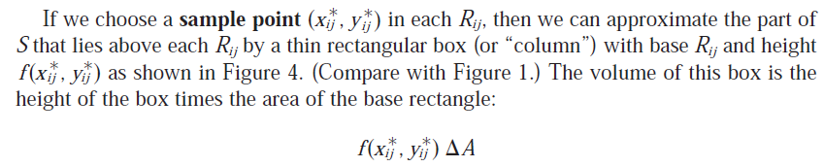
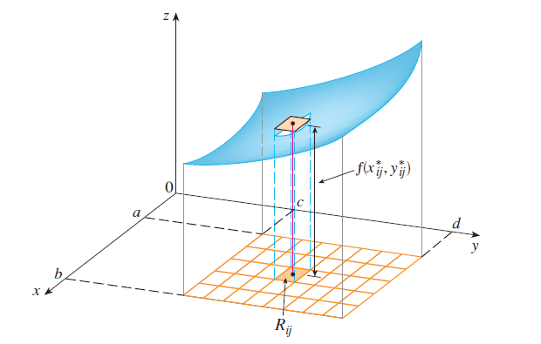

Slide 6

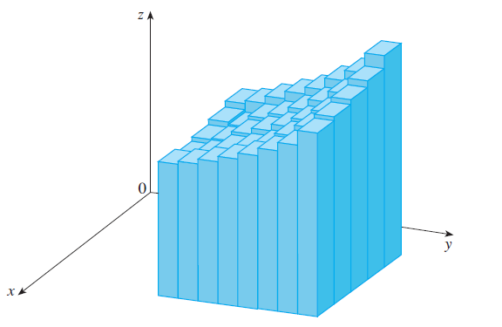
If we follow this procedure for all the rectangles and add the volumes of the corresponding boxes, we get an approximation to the total volume of S:

Slide 7

Our intuition tells us that the approximation given in the above formula becomes better as n and m become larger and so we would expect that

Slide 8
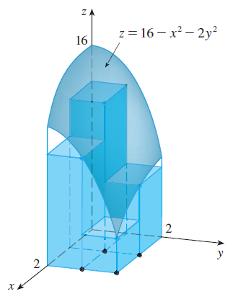
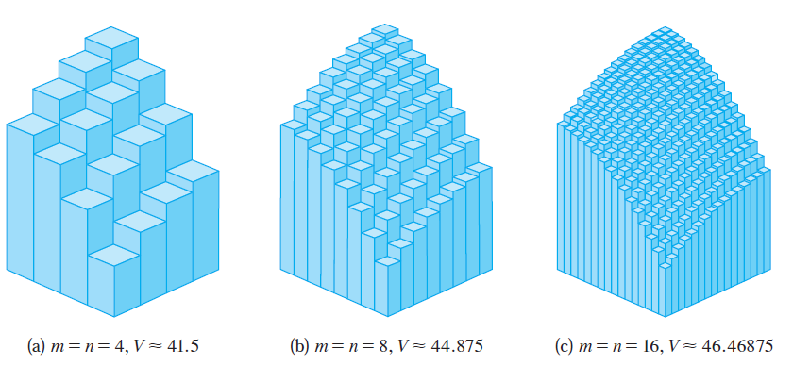

Slide 9

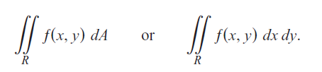
Definition: The double integral of over the rectangle R is
if this limit exists no matter what choices are made, and the function ƒ is said to be integrable, written as

Slide 10
It can be shown that if ƒ(x, y) is a continuous function throughout R, then ƒ is integrable, as in the single-variable case discussed in Chapter 5. Many discontinuous functions are also integrable, including functions that are discontinuous only on a finite number of points or smooth curves. We leave the proof of these facts to a more advanced text.

Slide 11
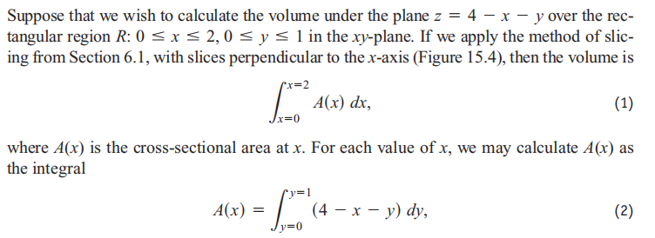
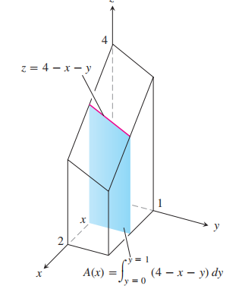

Slide 12
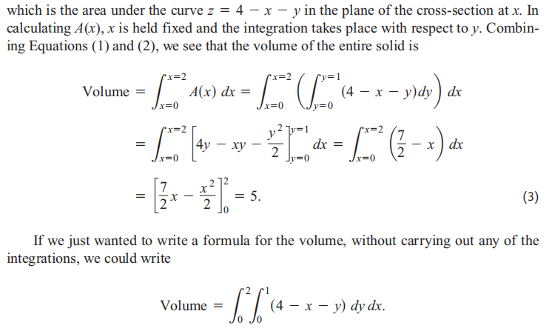

Slide 13
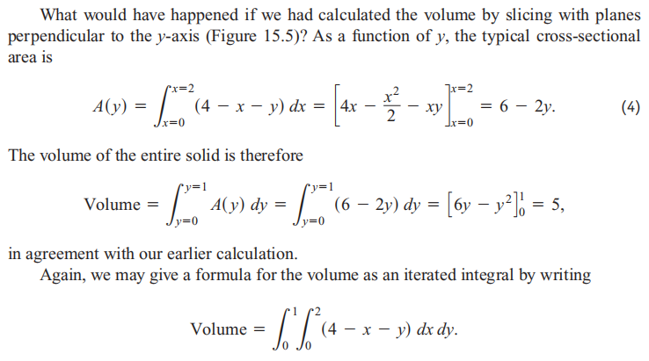

Slide 14
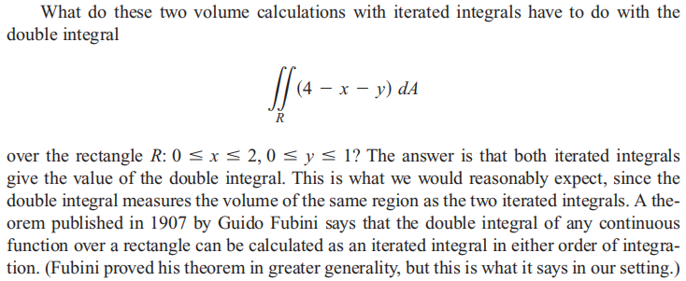

Slide 15
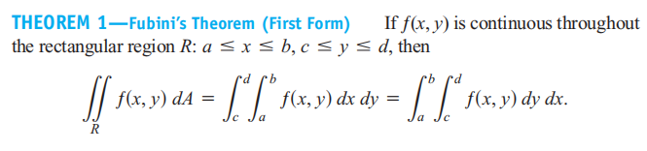
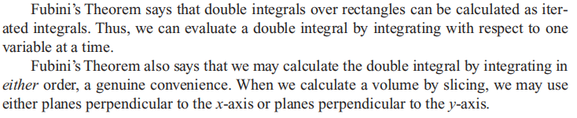

Slide 16
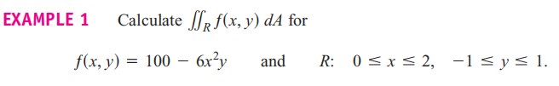
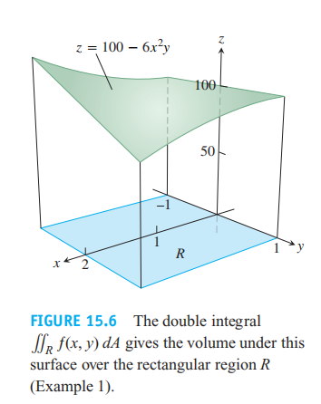

Slide 17
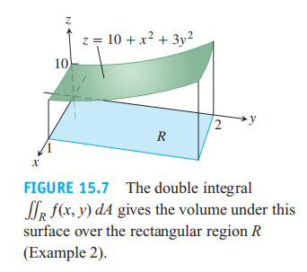

Slide 19
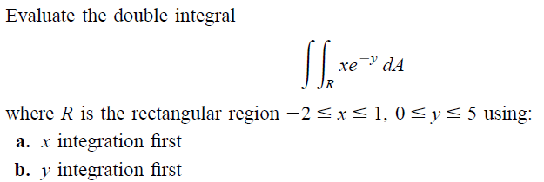
Example 3:

Slide 21
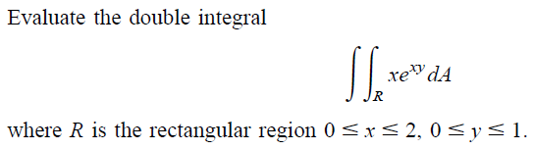
Example 4:

